Slide 1
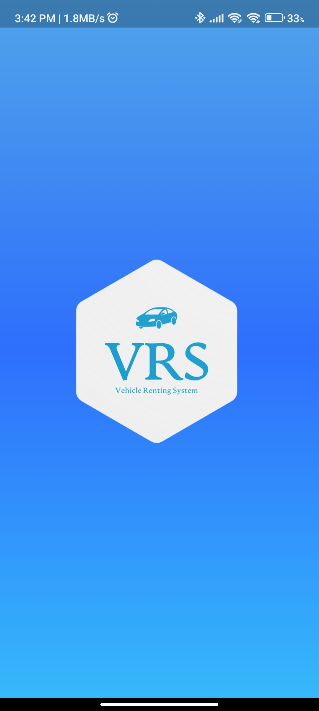
VEHICLE RENTAL SYSTEM
Project Group ID-27

Slide 2
Advantage
Team
Agenda
Introduction
Scope
Summary
Characteristics
SRS

Slide 3
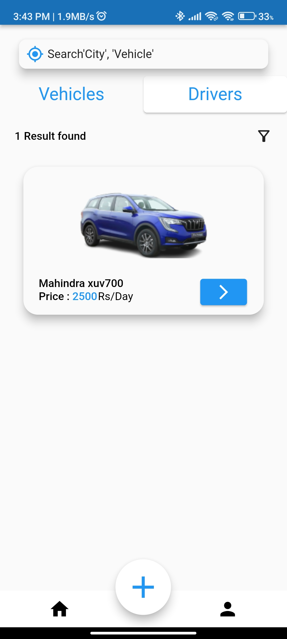
INTRODUCTION
Our system is a mobile application it will work as an interface between the Visitor, Renter, and Driver. In our system, any user can register themselves. Our system provides services for rents any available vehicle as per users choice or putting their vehicles for rent and can also apply for job as a driver in our application.

Slide 4
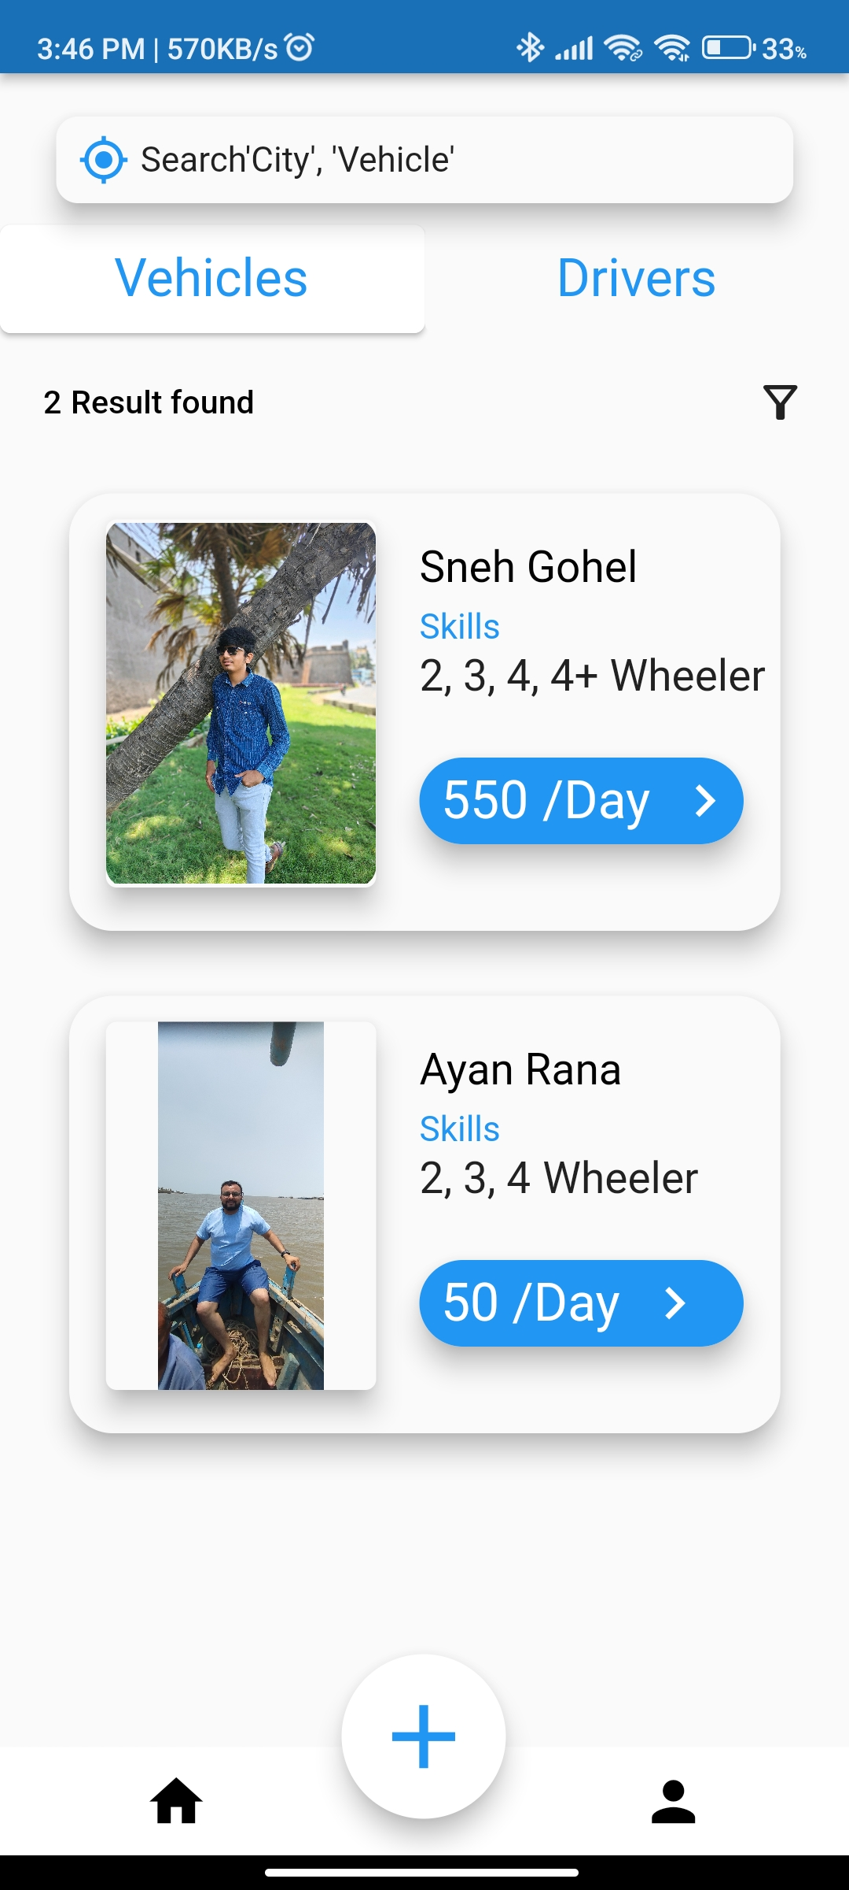
Characteristics
Provide the search facilities based on various factors, such as vehicles or their types or according to location.
It stores all your past booked information and also easy to retrieves that information.
It displays descriptive information about the vehicle, renter, visitor, and driver.
It efficiently manages all the information of all existing entities.
Modification of the information is also available but only authorized users can modify their data, others can only see the information but cannot modify it.

Slide 5
ADVANTAGES
Our vehicle rental system is developed to provide the following services.
Visitors can book a vehicle on rent online anytime, anywhere.
Every work process activity will be done by the system means no need to waste time on that work.
No, physical work required to find renter or find some particular vehicle because all work will be done on the application.
Any Driver can apply for driving vehicle at a nearby location.
It is easy to use and user friendly.
Secure Authentication with QR code with every booking.
A vehicle which is displayed on the home page is according to the user’s location.

Slide 6
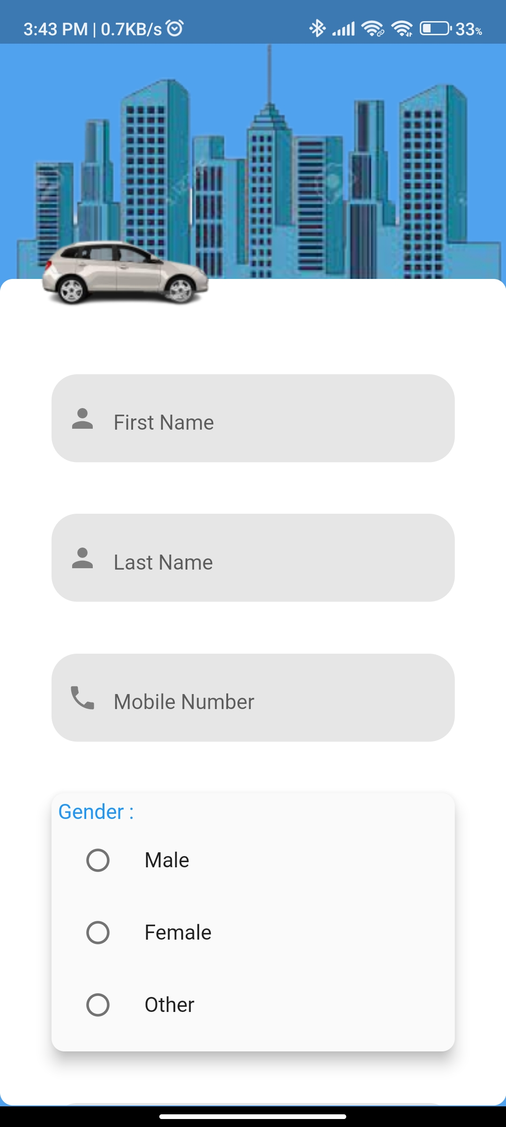
SCOPE
(Scope list of modules and their functions)
REGISTRATION
Every user has to register themselves into the system.
Users have to give some basic information at the time of registration. (Like First Name, Last Name, DOB, Mobile Number, Gender and Address etc.)
This information will be stored in database and use later on while login or booking, Without registration user cannot do anything in the system.
User need to set their User ID and the Password in this phase only

Slide 7
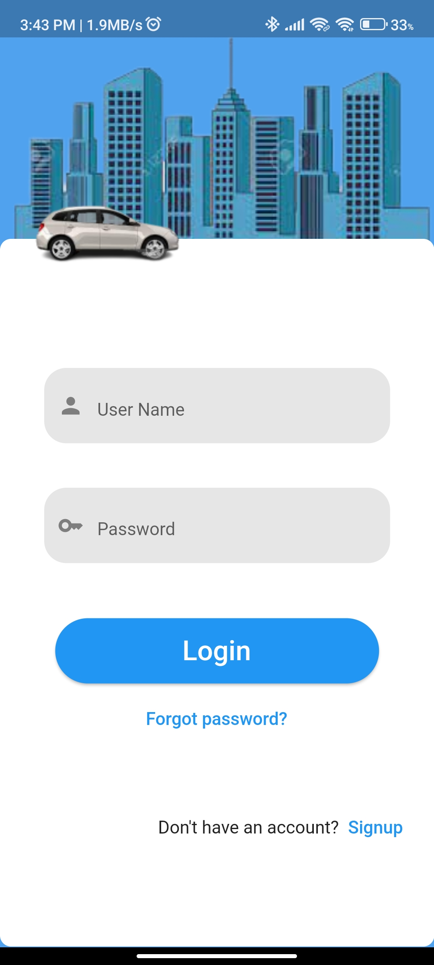
SCOPE
(Scope list of modules and their functions)
LOGIN
Every user can easily login into system with their User ID and Password that they created in the registration.
User must have to login into system to access their account.
Once logged into the system, the system will automatically enable auto login until the user is logged out.

Slide 8
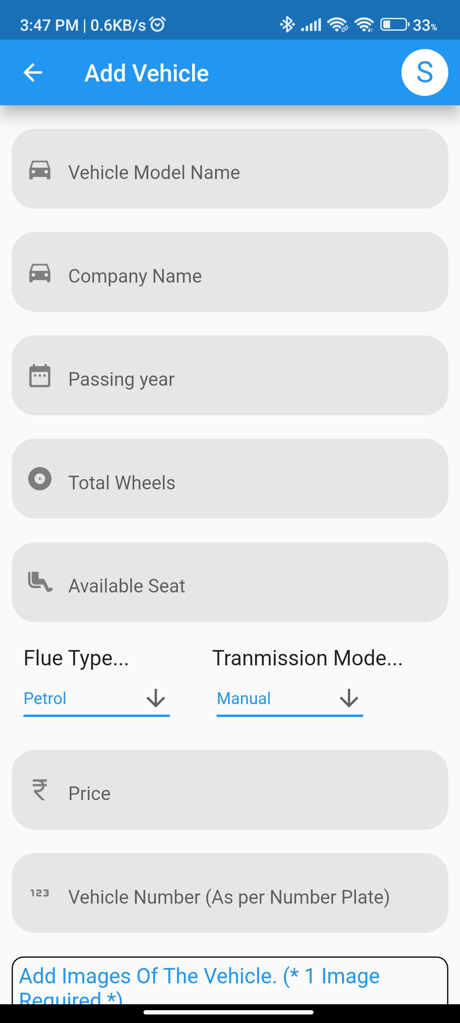
SCOPE
(Scope list of modules and their functions)
RENTING VEHICLE
Anyone who wants to put their vehicle on rent then user should have to give some basic information of their vehicle in the system.
The user needs to click in “ADD” button after filling the information of vehicle.
Now that vehicle will be shown to the visitor according to location.

Slide 9
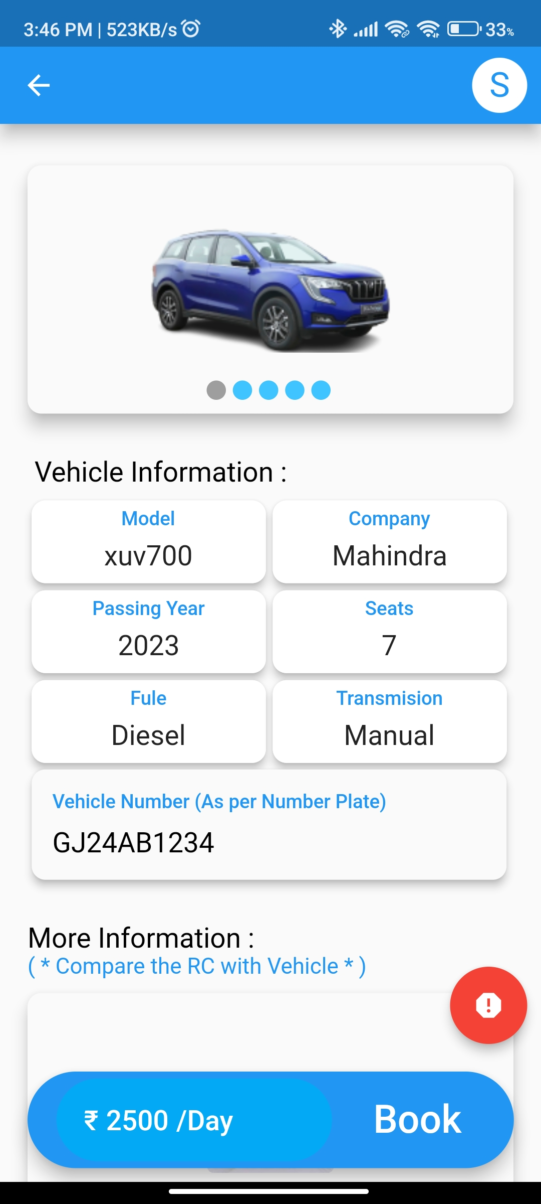
SCOPE
(Scope list of modules and their functions)
Booking Vehicle
Visitor can book any specific vehicle online by visiting in the application after registration/login.
After clicking on particular vehicle, the visitor can view the information of selected vehicle.
Renter will get notified after their vehicle will book.

Slide 10
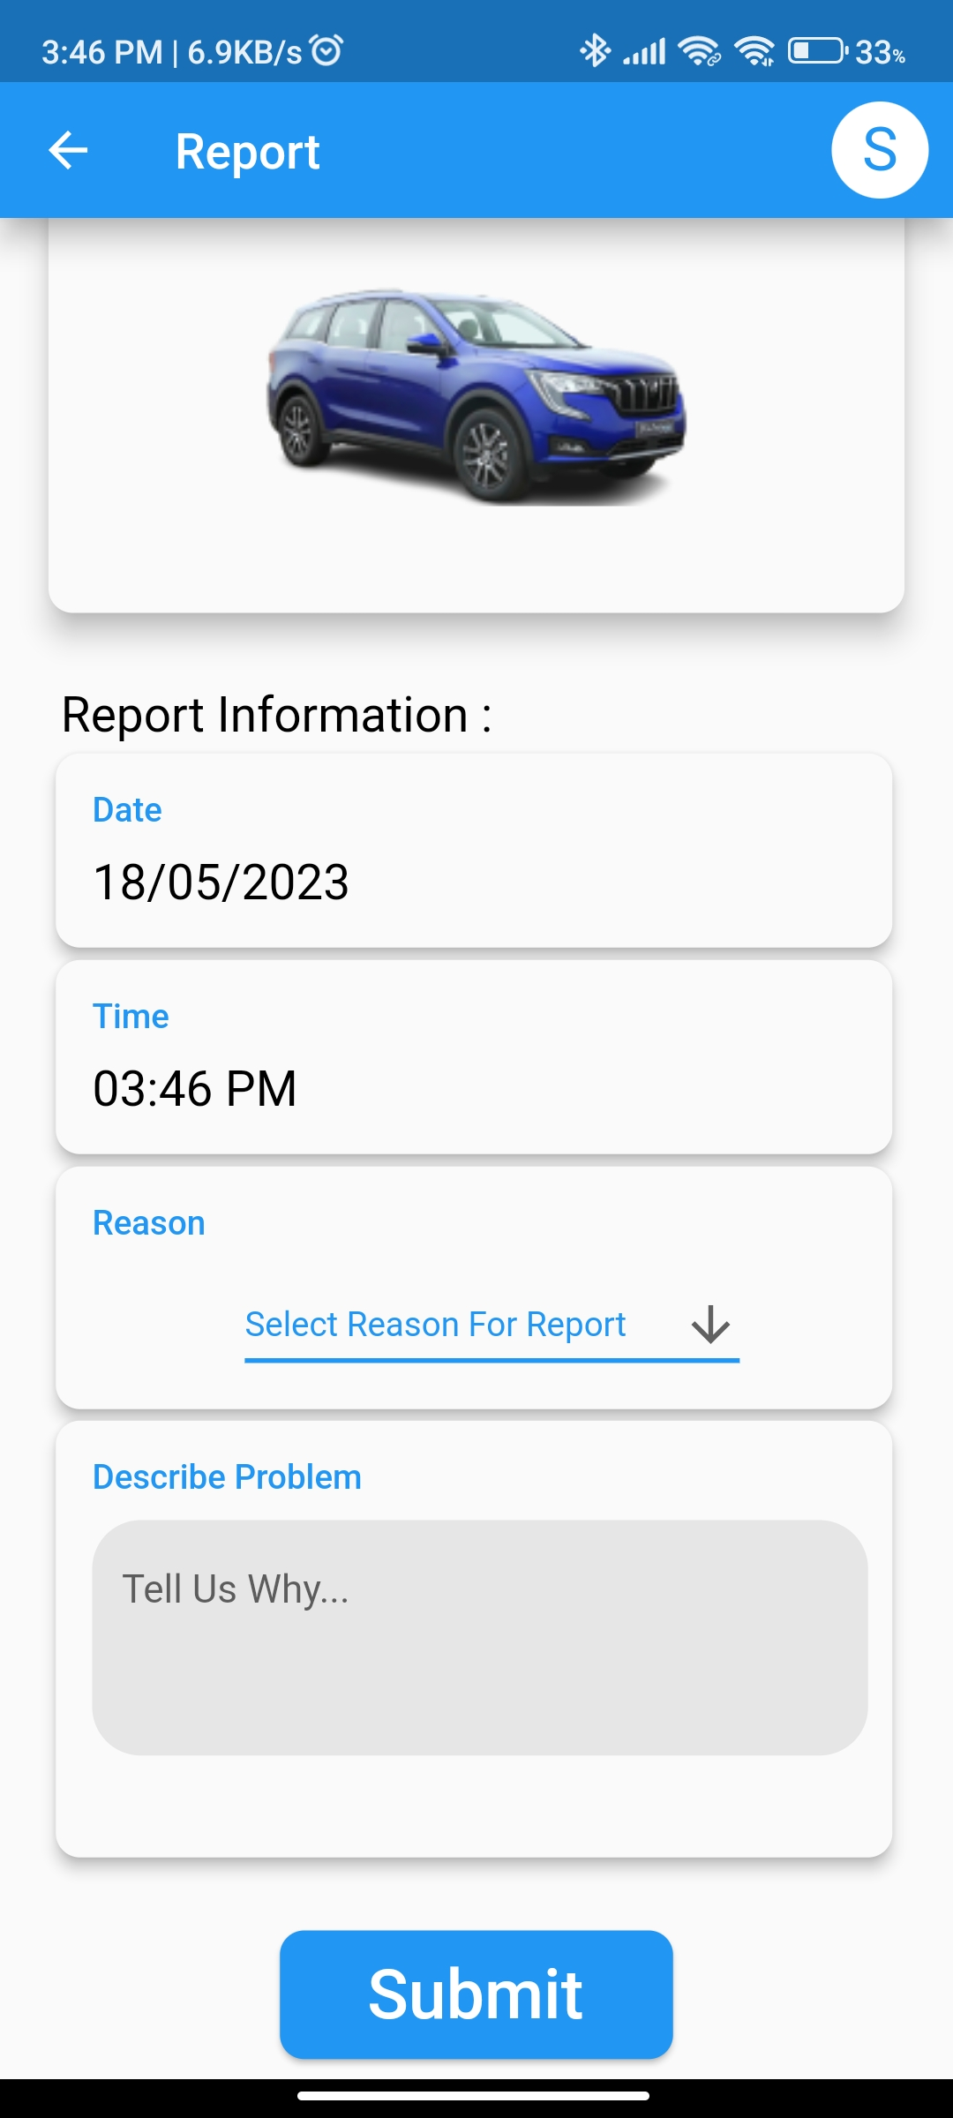
SCOPE
(Scope list of modules and their functions)
REPORT
Reports are used to notify the user if any problematic activity found like Mismatch documents, Wrong information or anything else.
The report here is used to protect our application environment.
If 5 reports are reported to any vehicle or driver then that vehicle or driver will be discontinue from the application.
If 10 reports are reported to same vehicle or driver then that owner of vehicle or driver will be permanent blocked from the application.

Slide 11
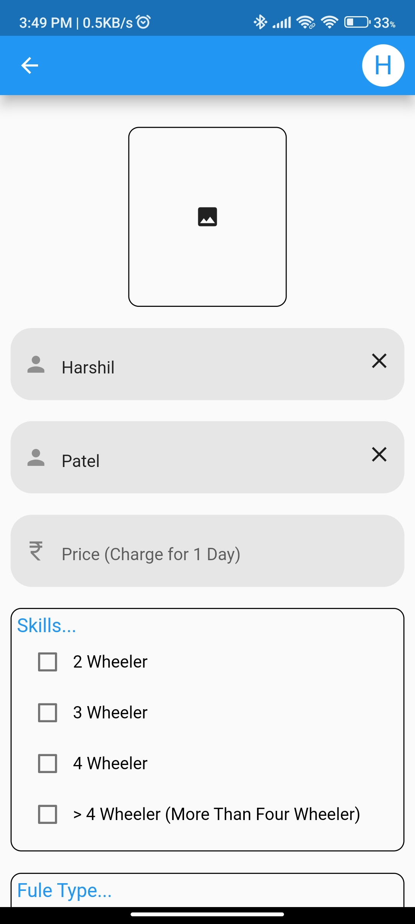
SCOPE
(Scope list of modules and their functions)
Applying as Driver
User can also apply as a driver after registration.
User has to give information to prove his driving skills.
Driver will also get the notification if anyone will book driver for a vehicle.

Slide 12
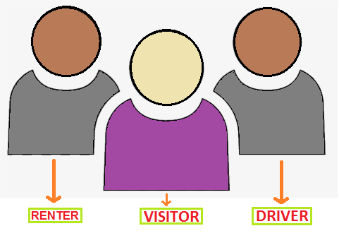
SOFTWARE REQUIREMENT SPECIFICATION
(Types of User)

Slide 13
FUNCTIONAL REQUIREMENTS
A new user should be able to register and an old user can log in.
User can rent their vehicles or also apply as a driver.
Visitor can book a vehicle as per their requirements for rent.
The database will automatically be updated when a new vehicle is added for rent and the result of that will be reflected on the GUI also.
Renter will get notified after their vehicle will book.
When a visitor or renter will see or find a mismatch between the visitor’s details or vehicle’s details then they can report against them immediately from the application.
When the visitor wants a driver for some vehicle so visitor can book the appropriate driver for that vehicle.
Driver will also get the notification if anyone will book driver for a vehicle.
The renter can cancel the booked vehicle through application and the visitor also notified by the application & vice versa.
Driver has right to cancel booked driving schedule.

Slide 14
NON-FUNCTIONAL REQUIREMENTS
Security :-
The system provides a username and password to prevent the system from unauthorized access.
Performance and Response :-
Time The system should have a high-performance rate while executing user inputs.
Availability :-
This system must be accessible at all times, 24 hours a day, seven days a week. In the event of a catastrophic system will not get any kind of failure.
Ease of Use :-
Given the customer level of understanding, a basic yet high -quality user interface should be created to make it simple to comprehend and need minimal training.

Slide 15
Software And Hardware Requirements
Minimum Software
Requirements :
Minimum Hardware Requirements :
Processor : Almost compatible with every processor.
Memory : 512MB or more.
Disk : 100MB.
IOS Or Android operating system.
IOS 8 Or 8+.
Android 5 or 5+.
Recommended Software Requirements :
Recommended Hardware Requirements :
IOS 10 or 10+.
Android Pie, 10 Or 10+.
Processor : MediaTek Helio A22, Samsung Exynos 7,
Snapdragon 215
Memory : 2GB
Disk : 512MB

Slide 16
SYSTEM ANALYSIS MODELING
Technical Feasibility :
The current system developed is technically feasible. It has a mobile-based user interface. Thus, it provides easy access to the maximum number of users easily. The database's purpose is to create, establish and maintain a workflow and dataflow among various entities to facilitate all concerned users in their various capacities or roles. Permission to the users would be granted based on the roles specified. Therefore, it provides the technical guarantee of accuracy, reliability, and security. The software and hardware requirements for the development of this project are not many and are already available and it’s all version is also free to use (like vs code etc…). To create a mobile-based application we already have flutter/android studio for mobile applications and for the database we have SQL SERVER / MY SQL. So, the project is done with the current equipment and existing software
technology.

Slide 17
SYSTEM ANALYSIS MODELING
Operational Feasibility:
This vehicle rental management system project well-planned design would ensure the optimal utilization of the computer resources and would help in the improvement of performance status.
Economic Feasibility:
Economic Feasibility of vehicle rental management system project A system can be developed technically and that will be used if installed must still be a good investment for the organization. For the economic feasibility only development cost in creating the vehicle rental system project. And it also does not require any additional hardware or software. So, for that, this system is economically feasible.

Slide 18
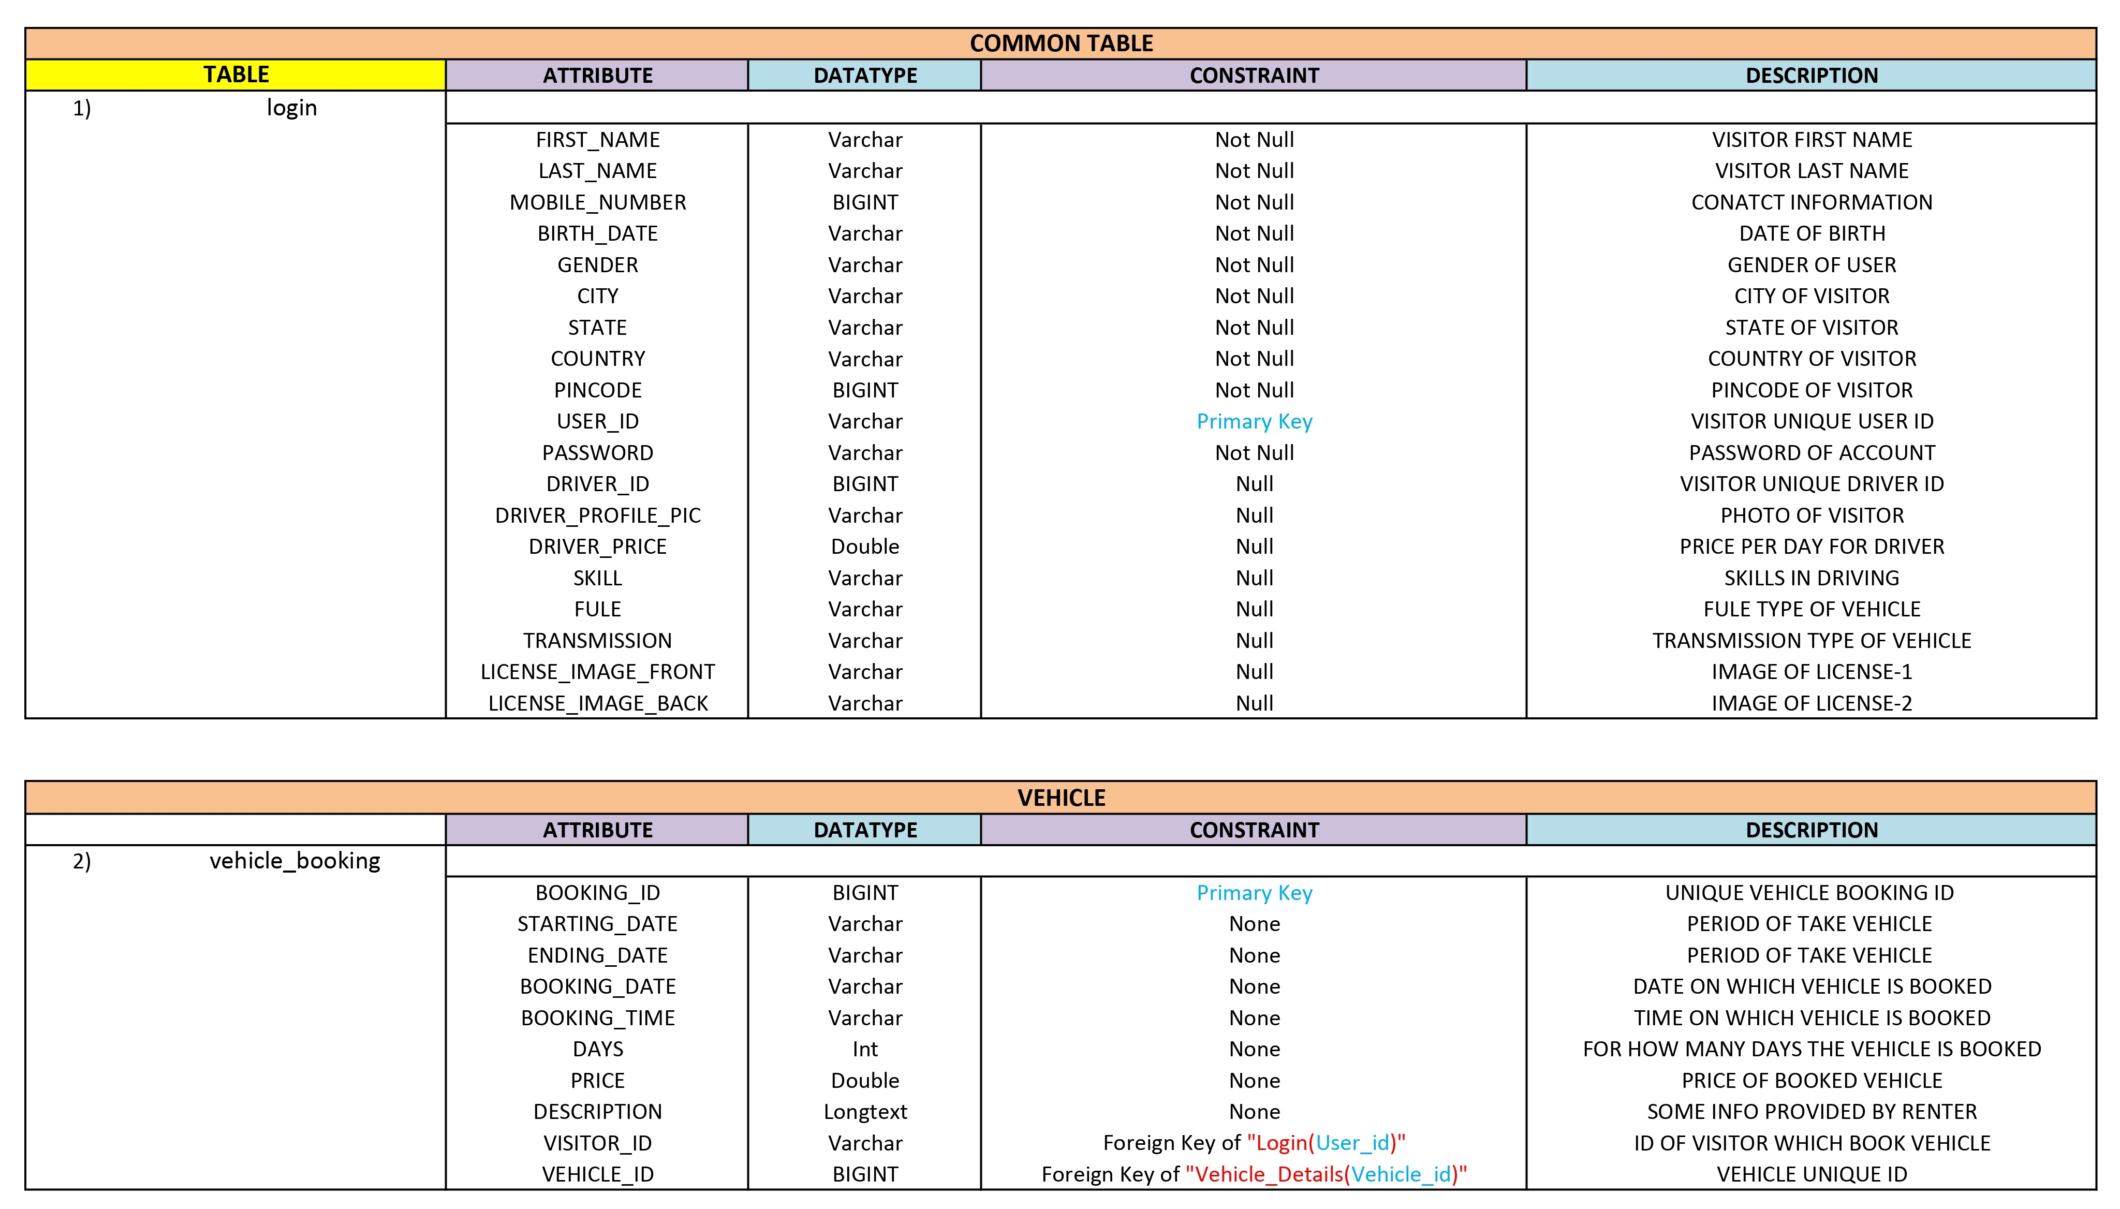
Data Directory

Slide 19
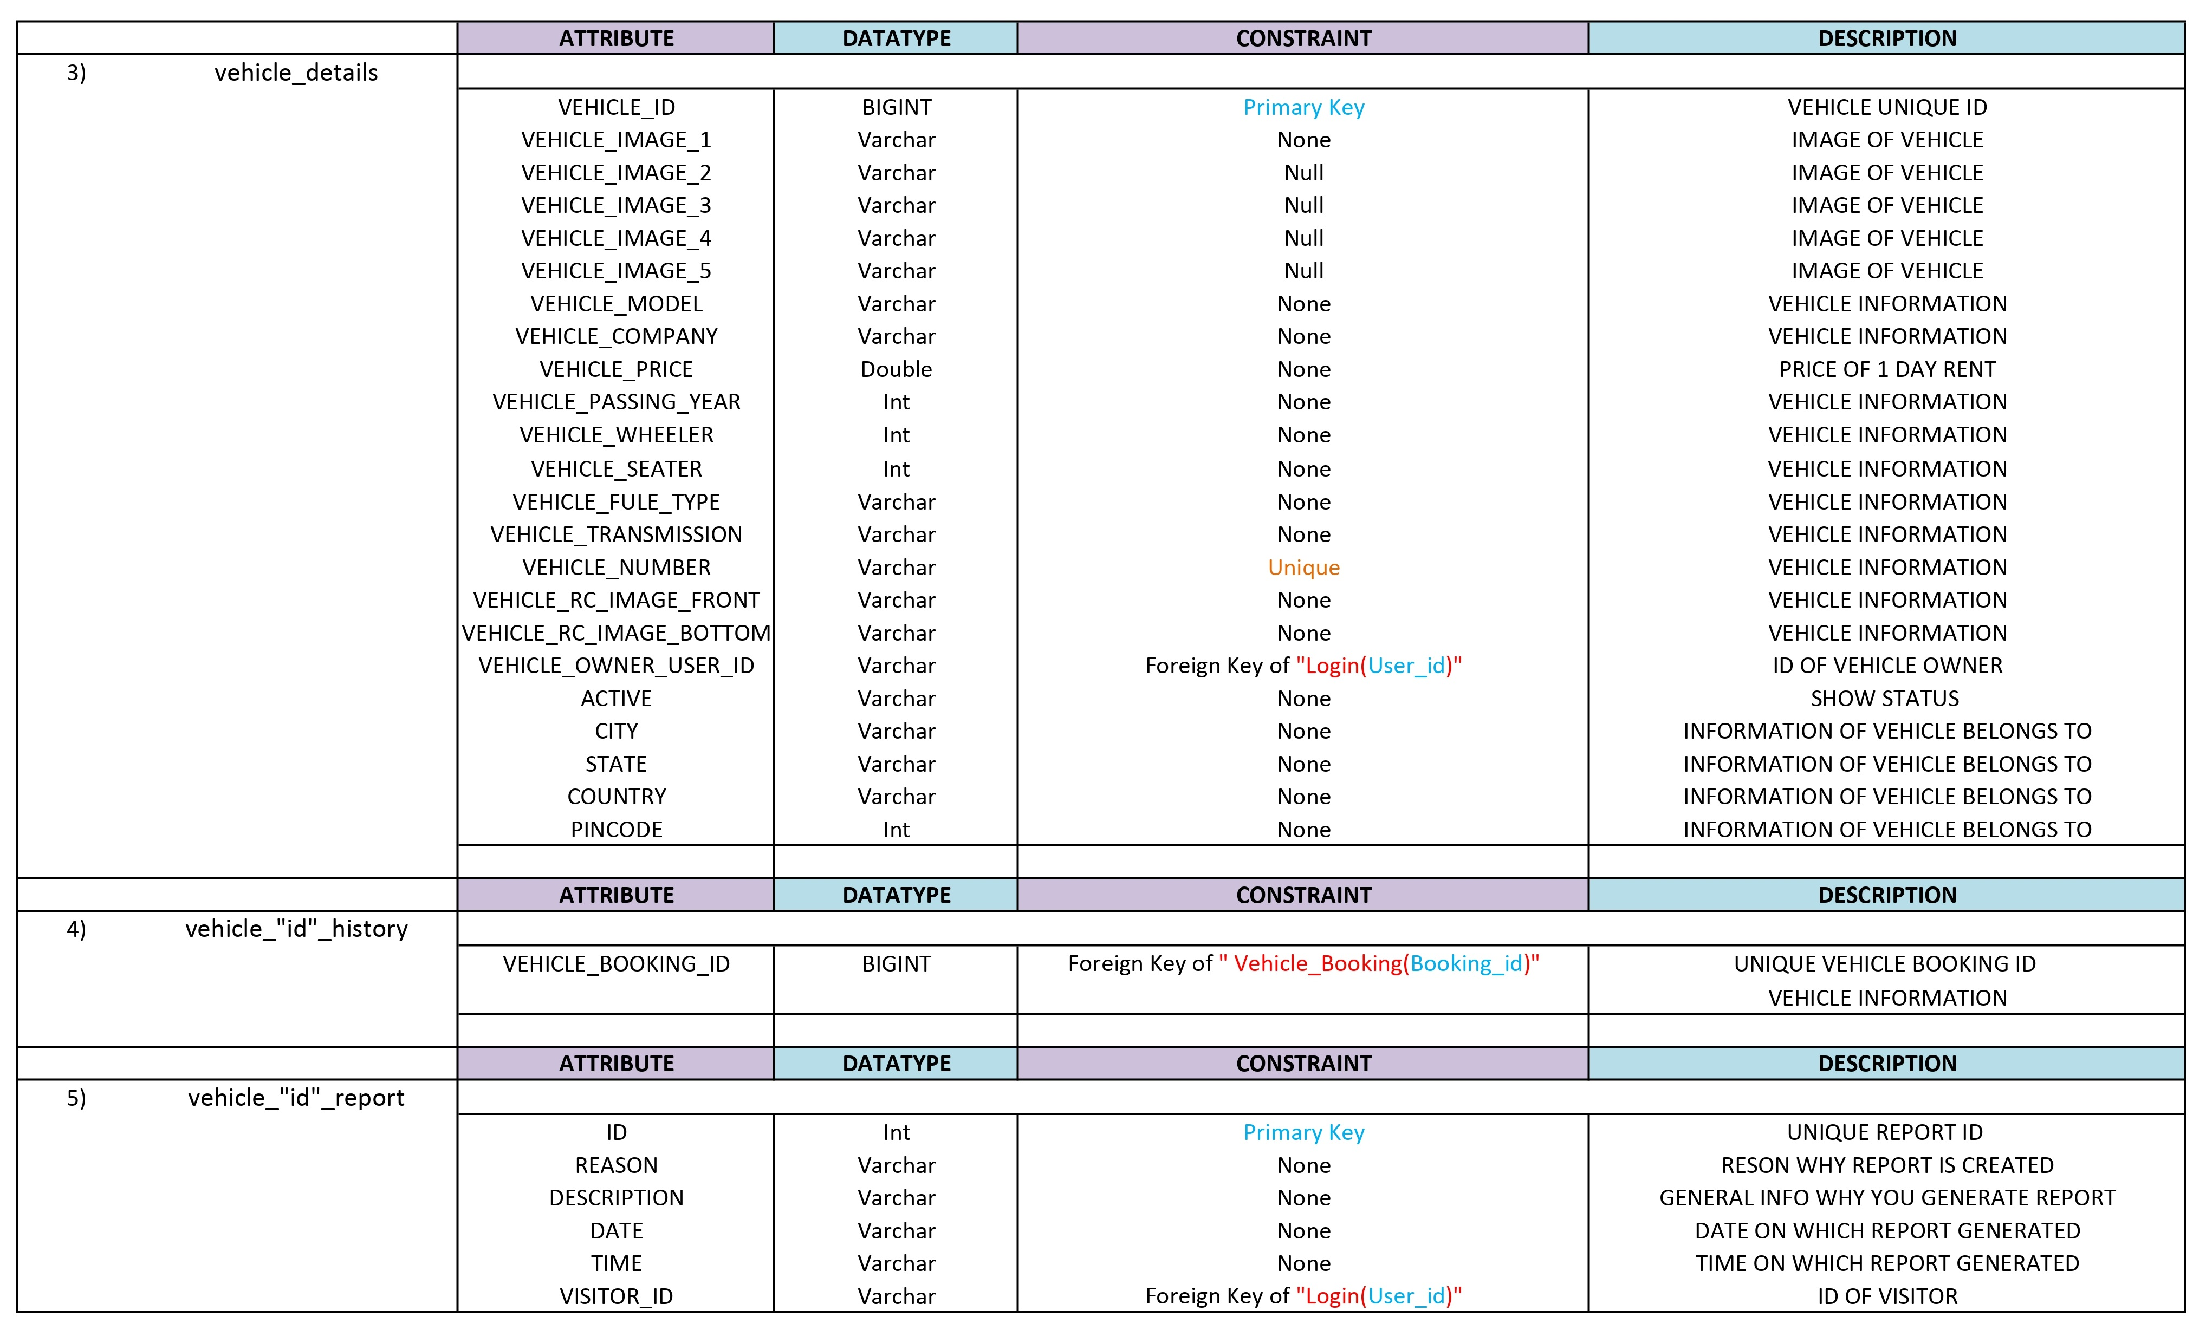
Data Directory

Slide 20
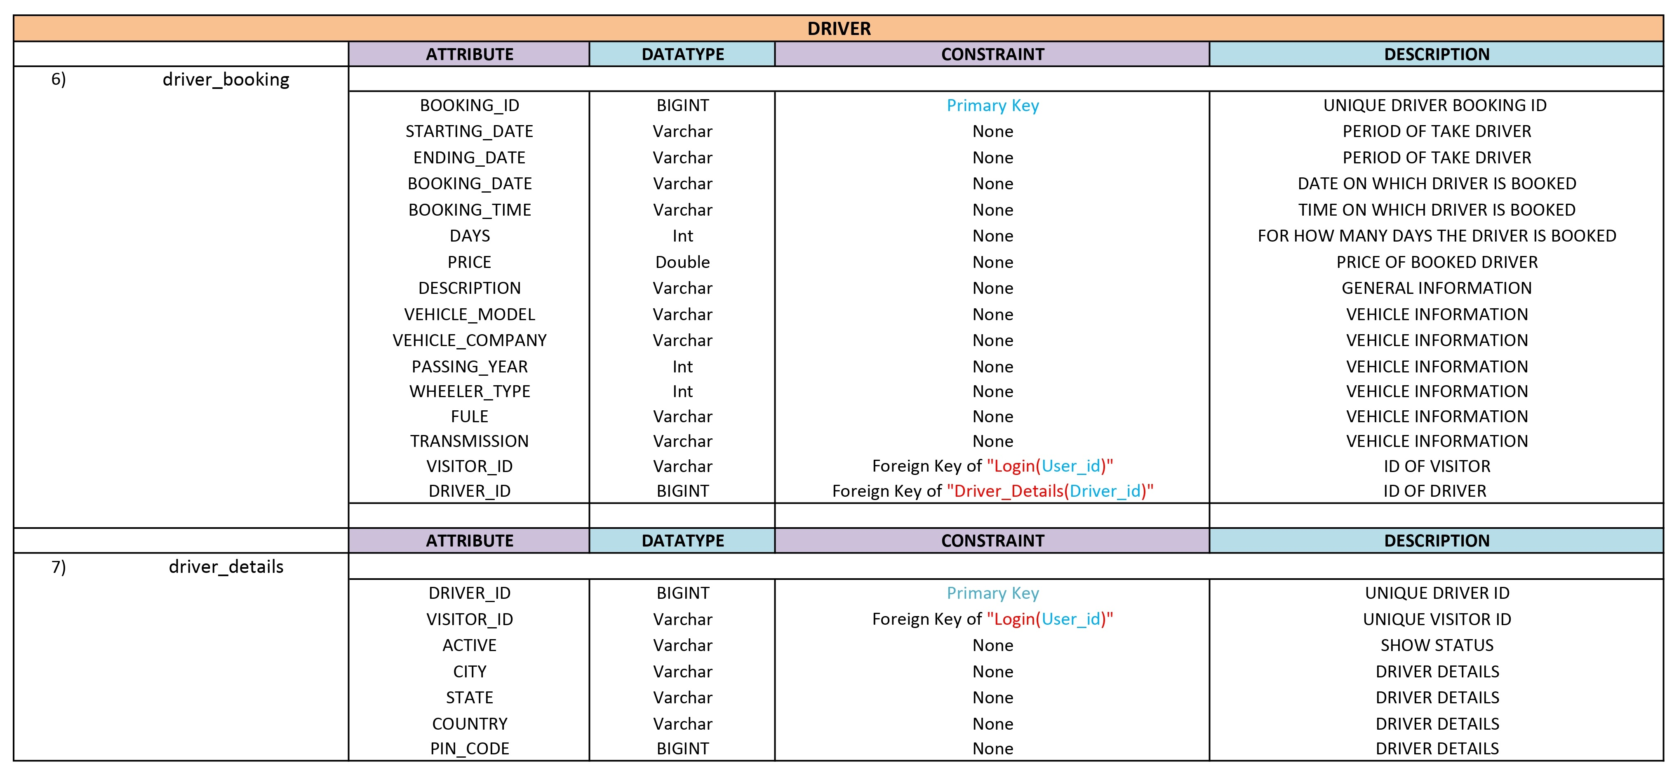
Data Directory

Slide 21
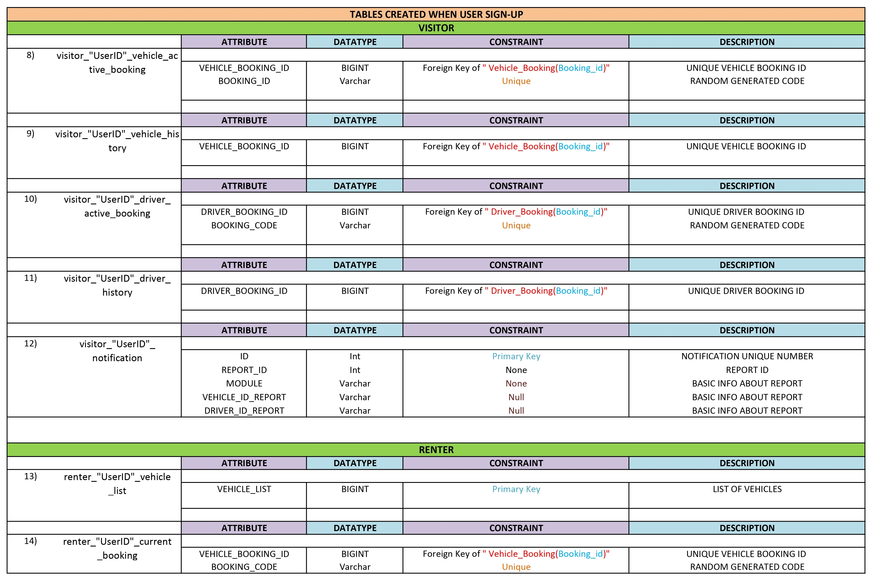
Data Directory

Slide 22
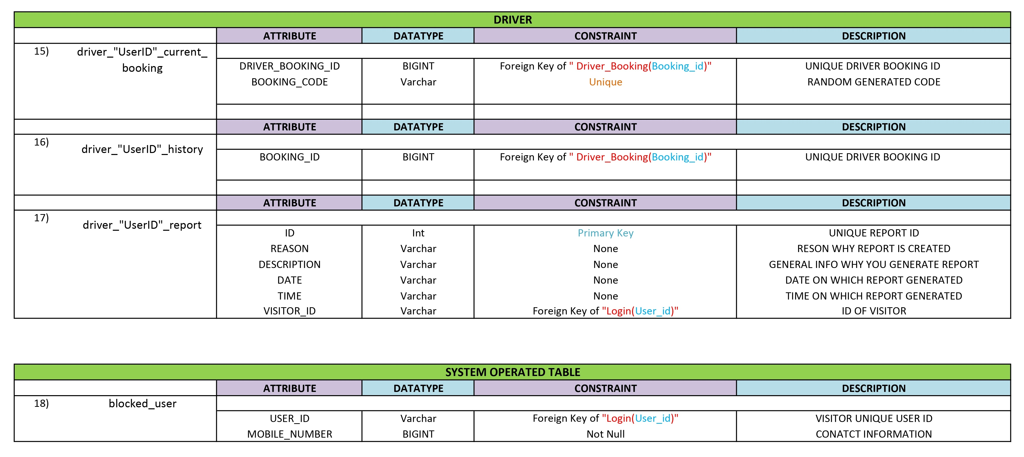
Data Directory

Slide 23
USE CASE DIAGRAM

Slide 24
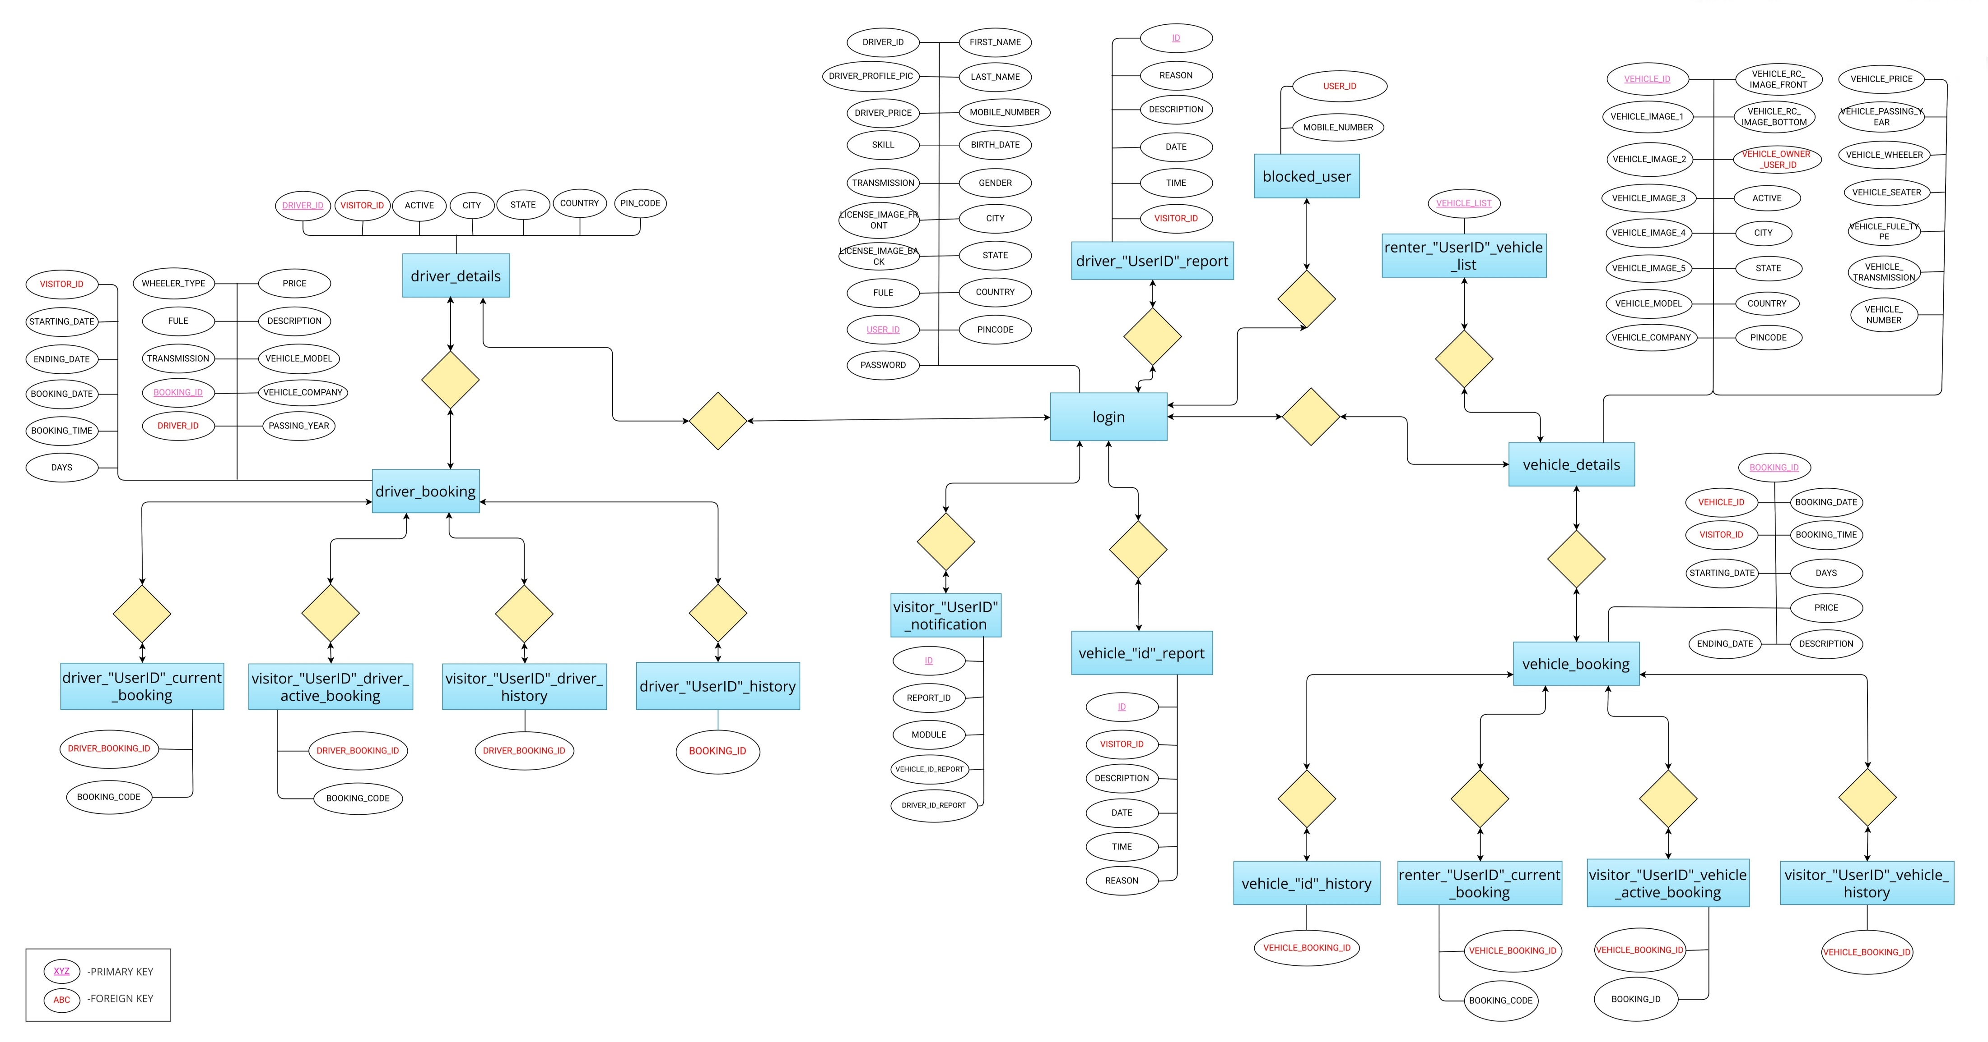
ER DIAGRAM

Slide 25
DATA FLOW DIAGRAM

Slide 26
DATA FLOW DIAGRAM

Slide 27
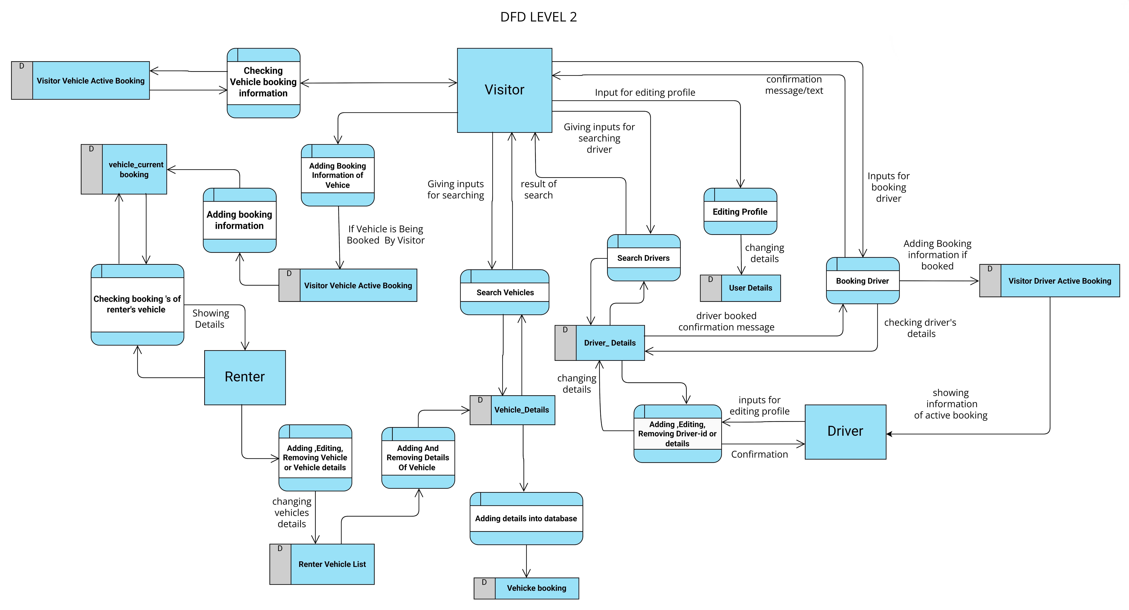
DATA FLOW DIAGRAM

Slide 28
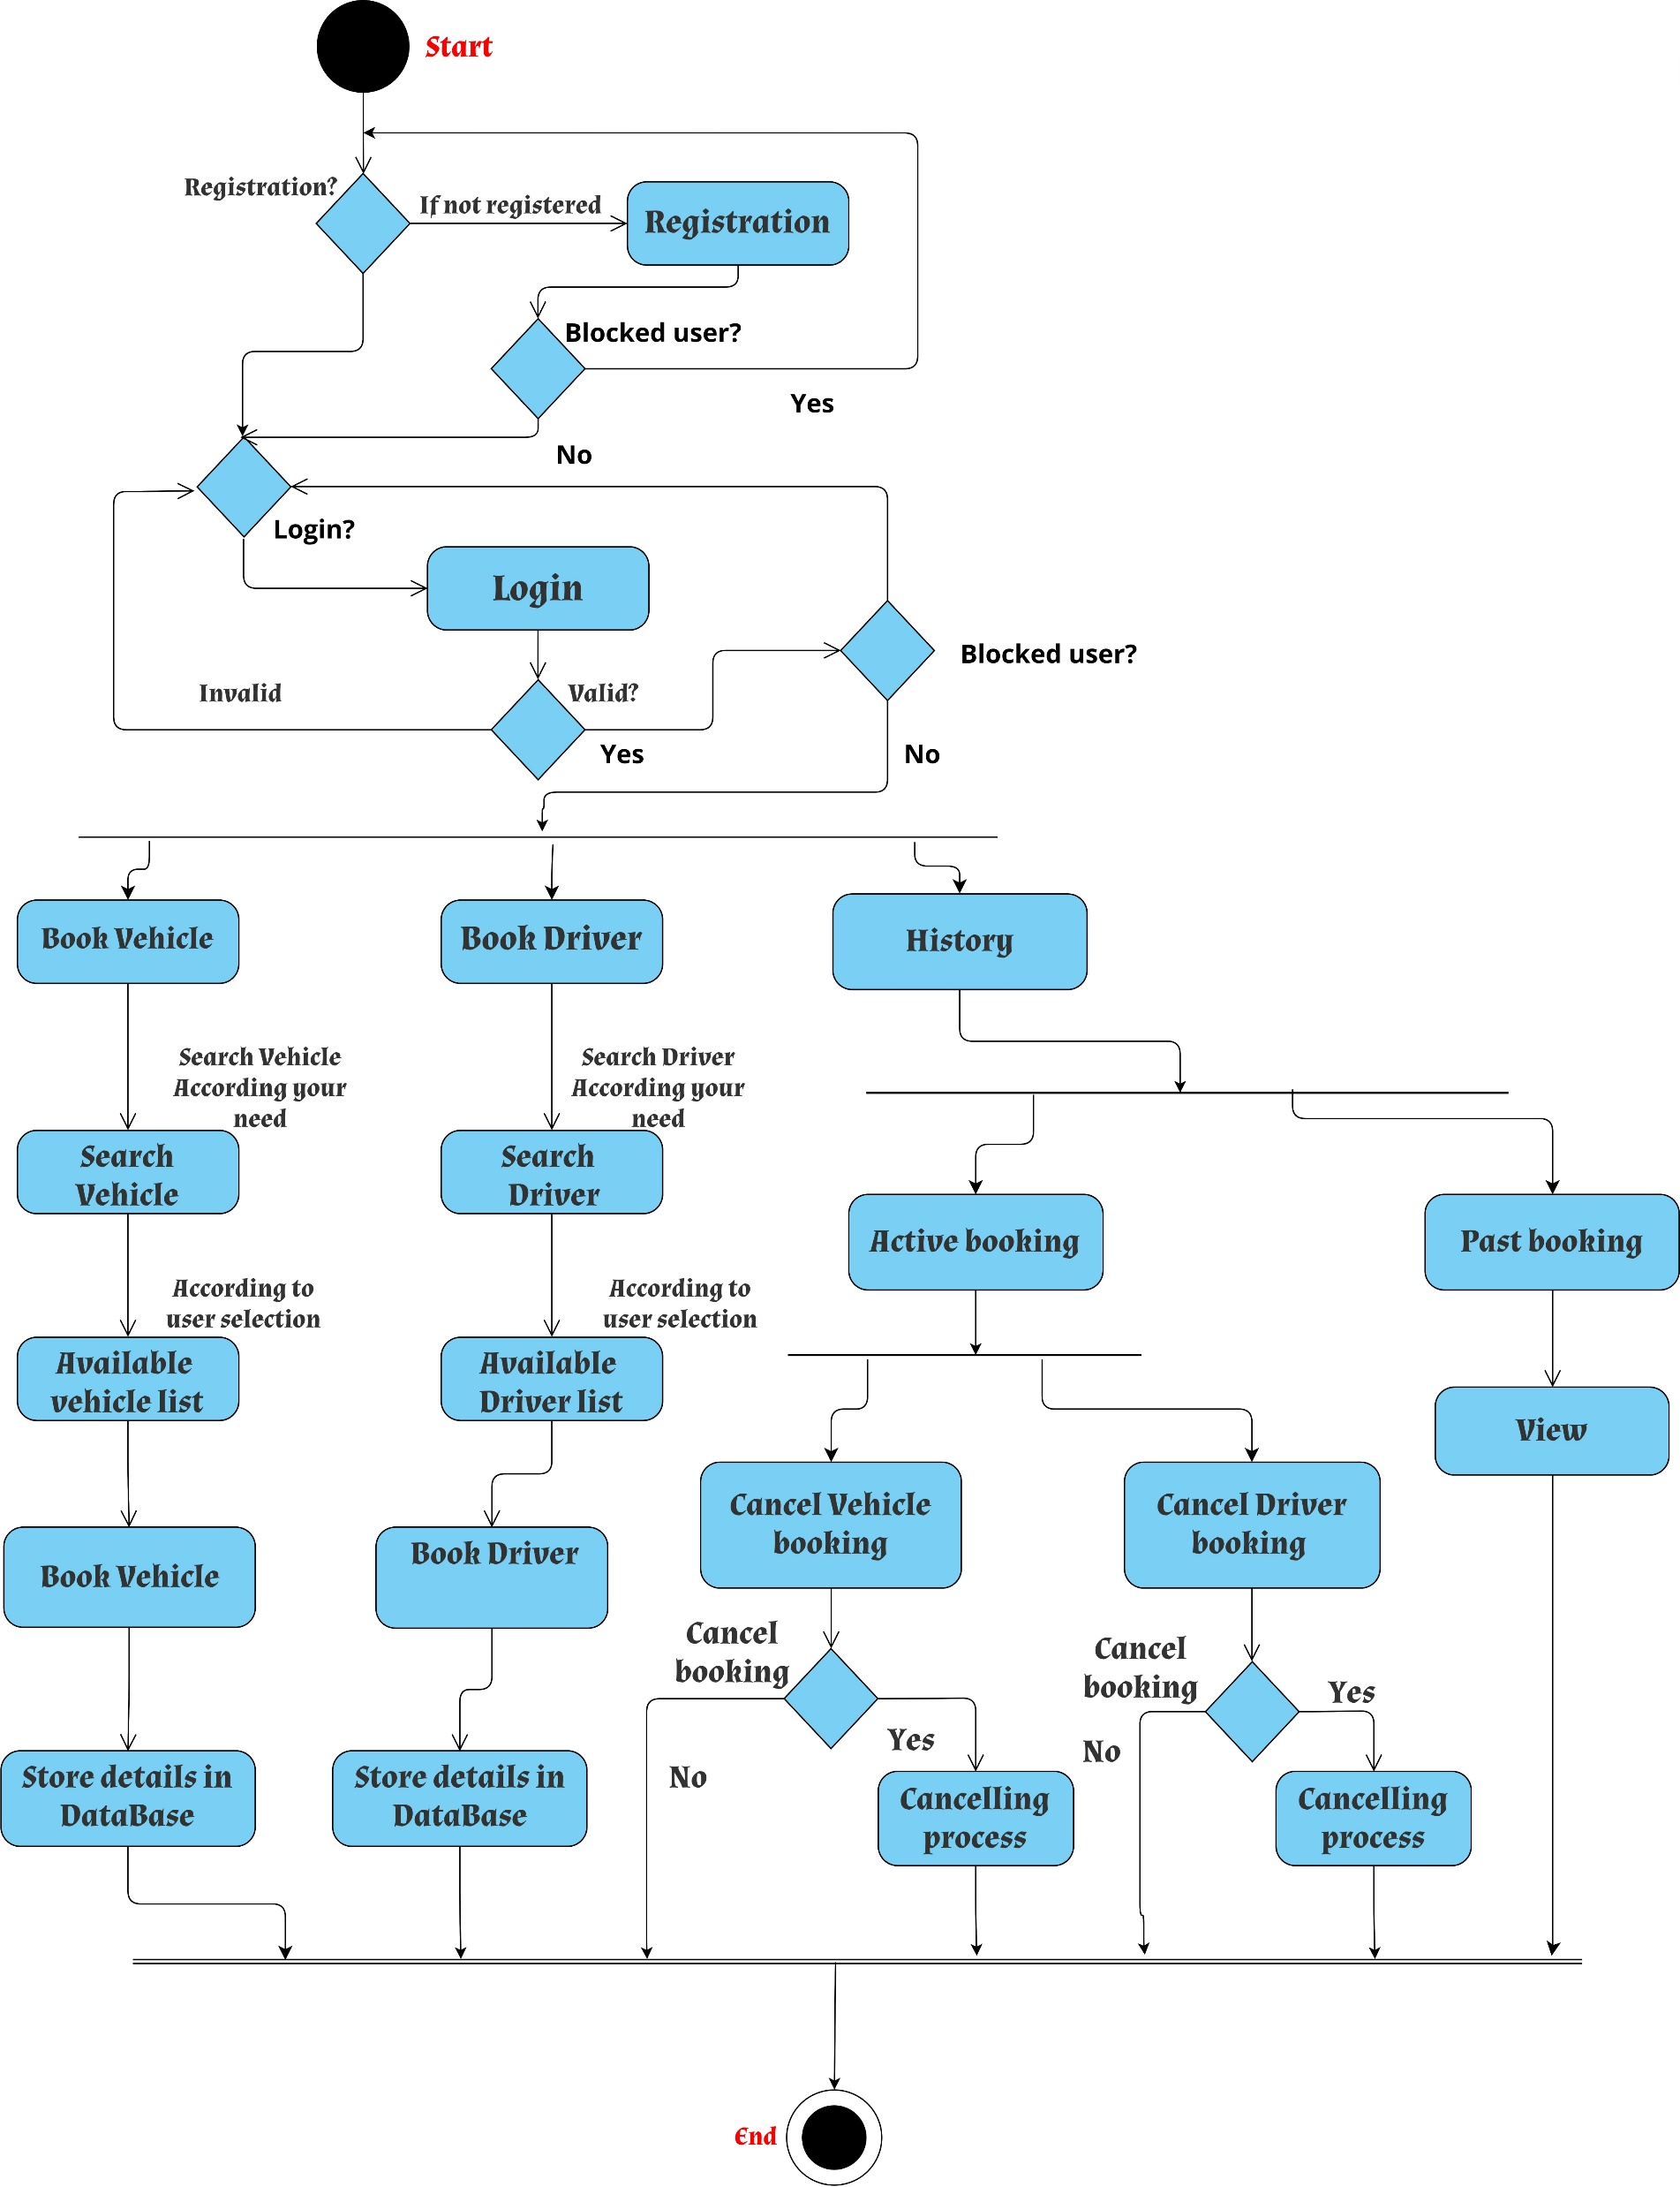
ACTIVITY DIAGRAM

Slide 29
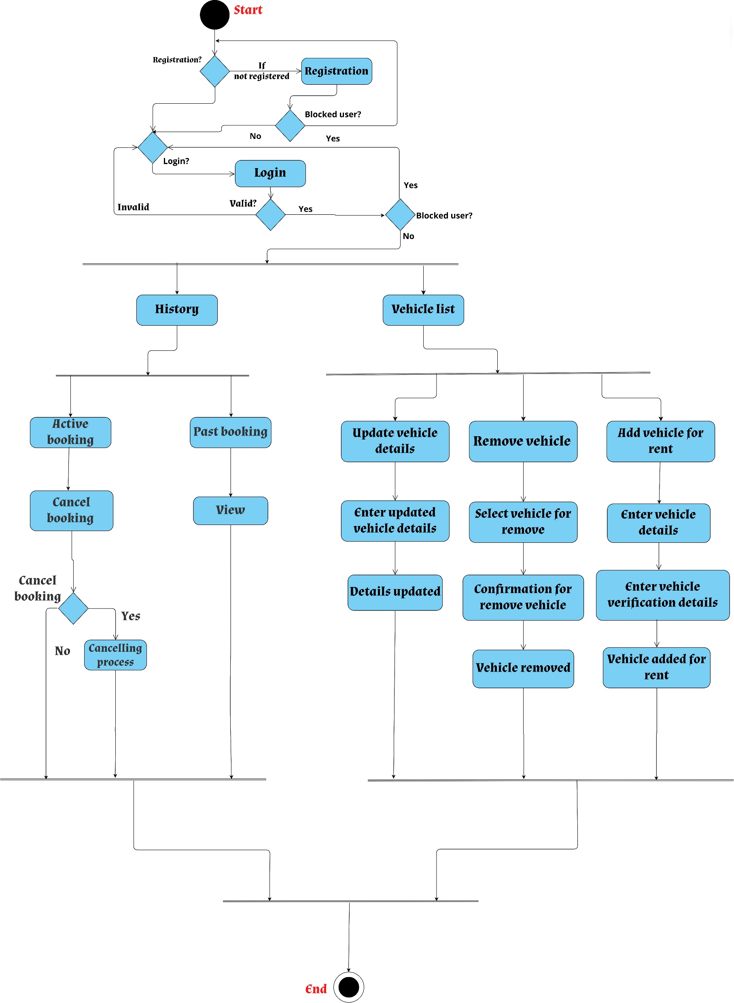
ACTIVITY DIAGRAM

Slide 30
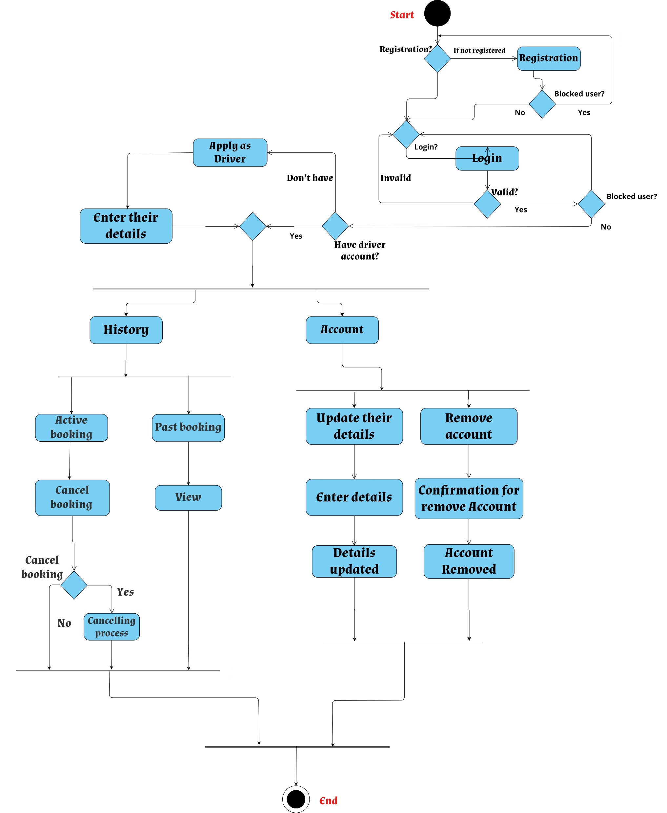
ACTIVITY DIAGRAM

Slide 31
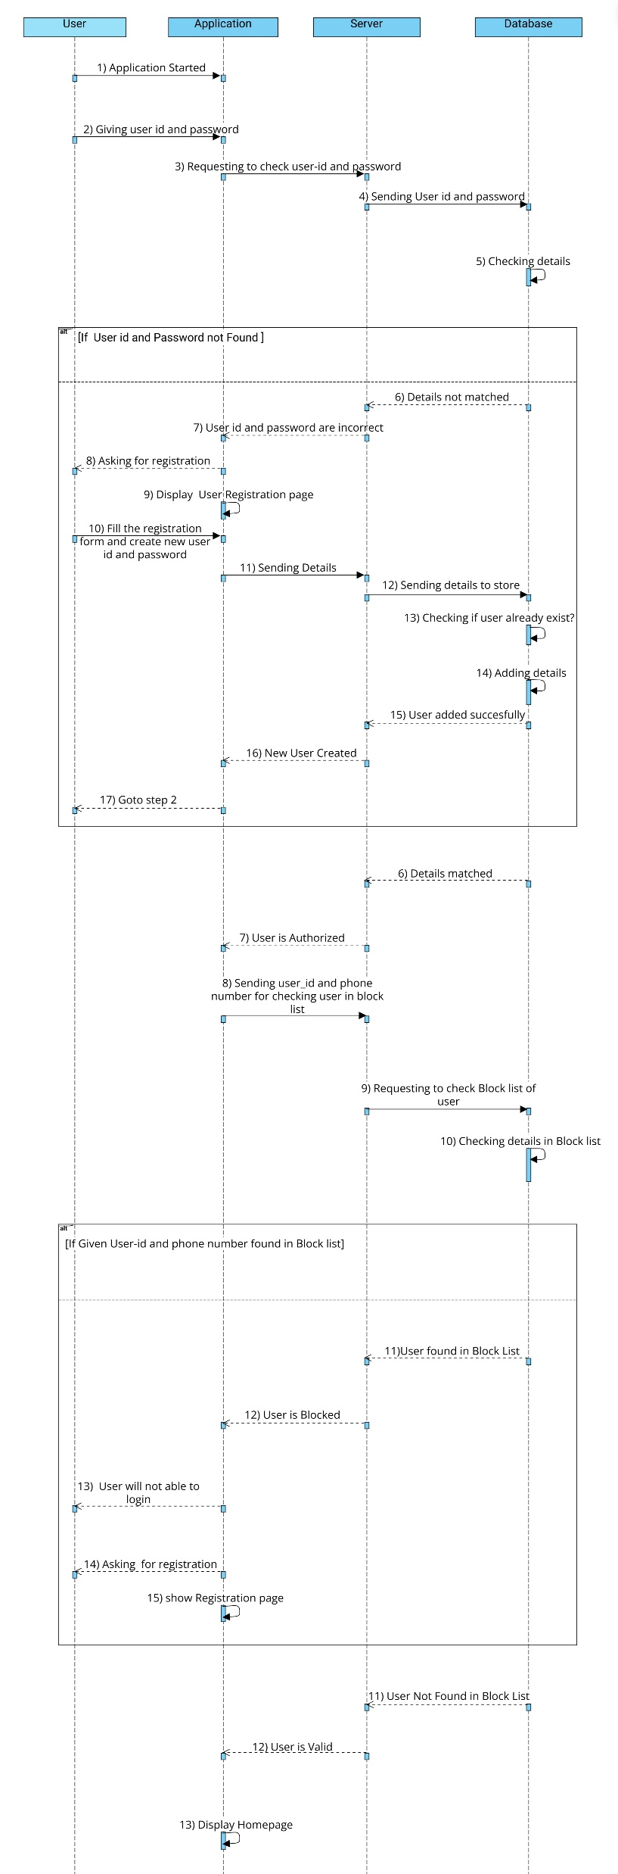
SEQUENCE DIAGRAM
LOGIN SEQUENCE DIAGRAM

Slide 32
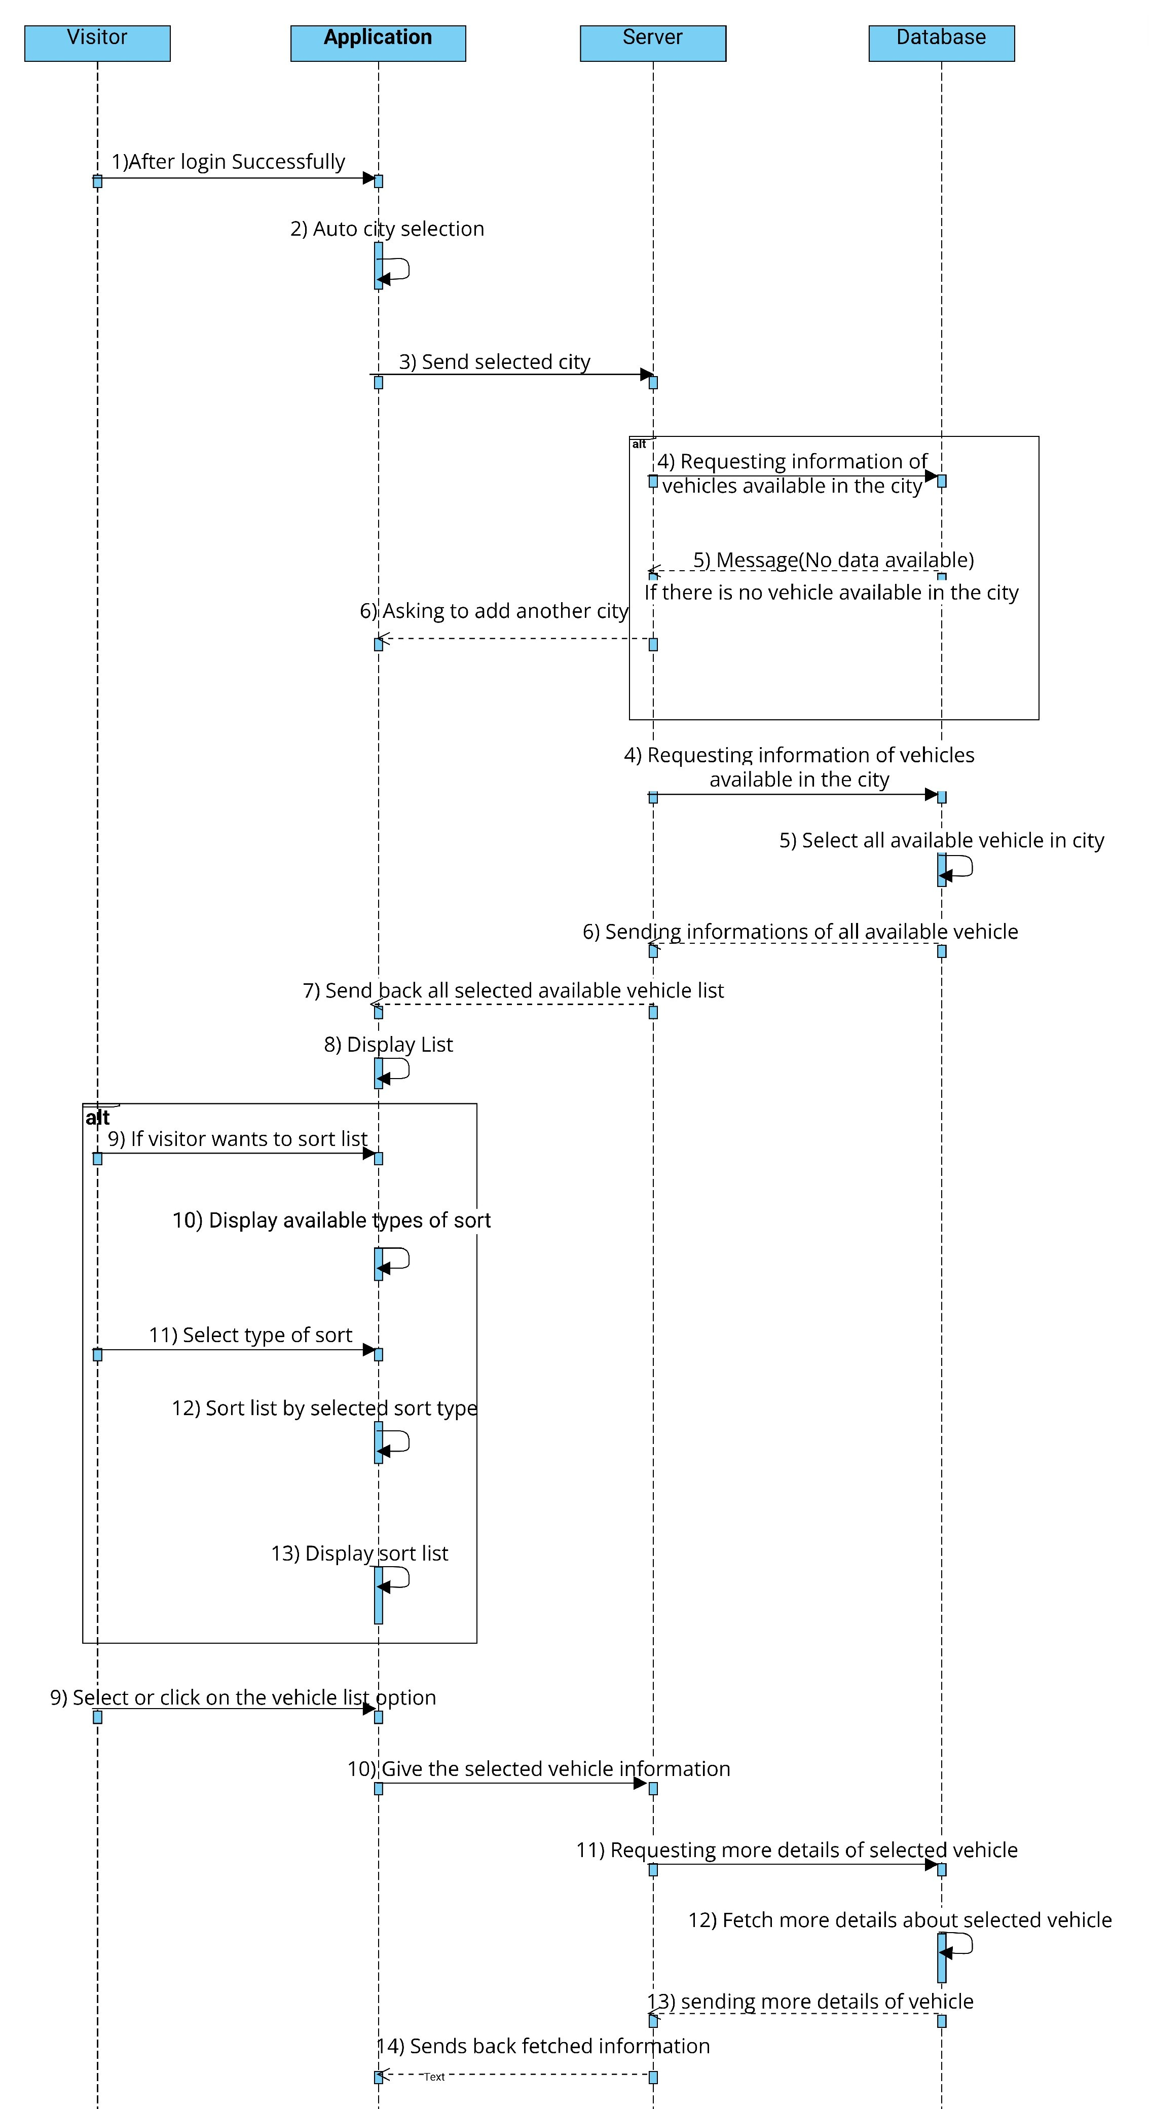
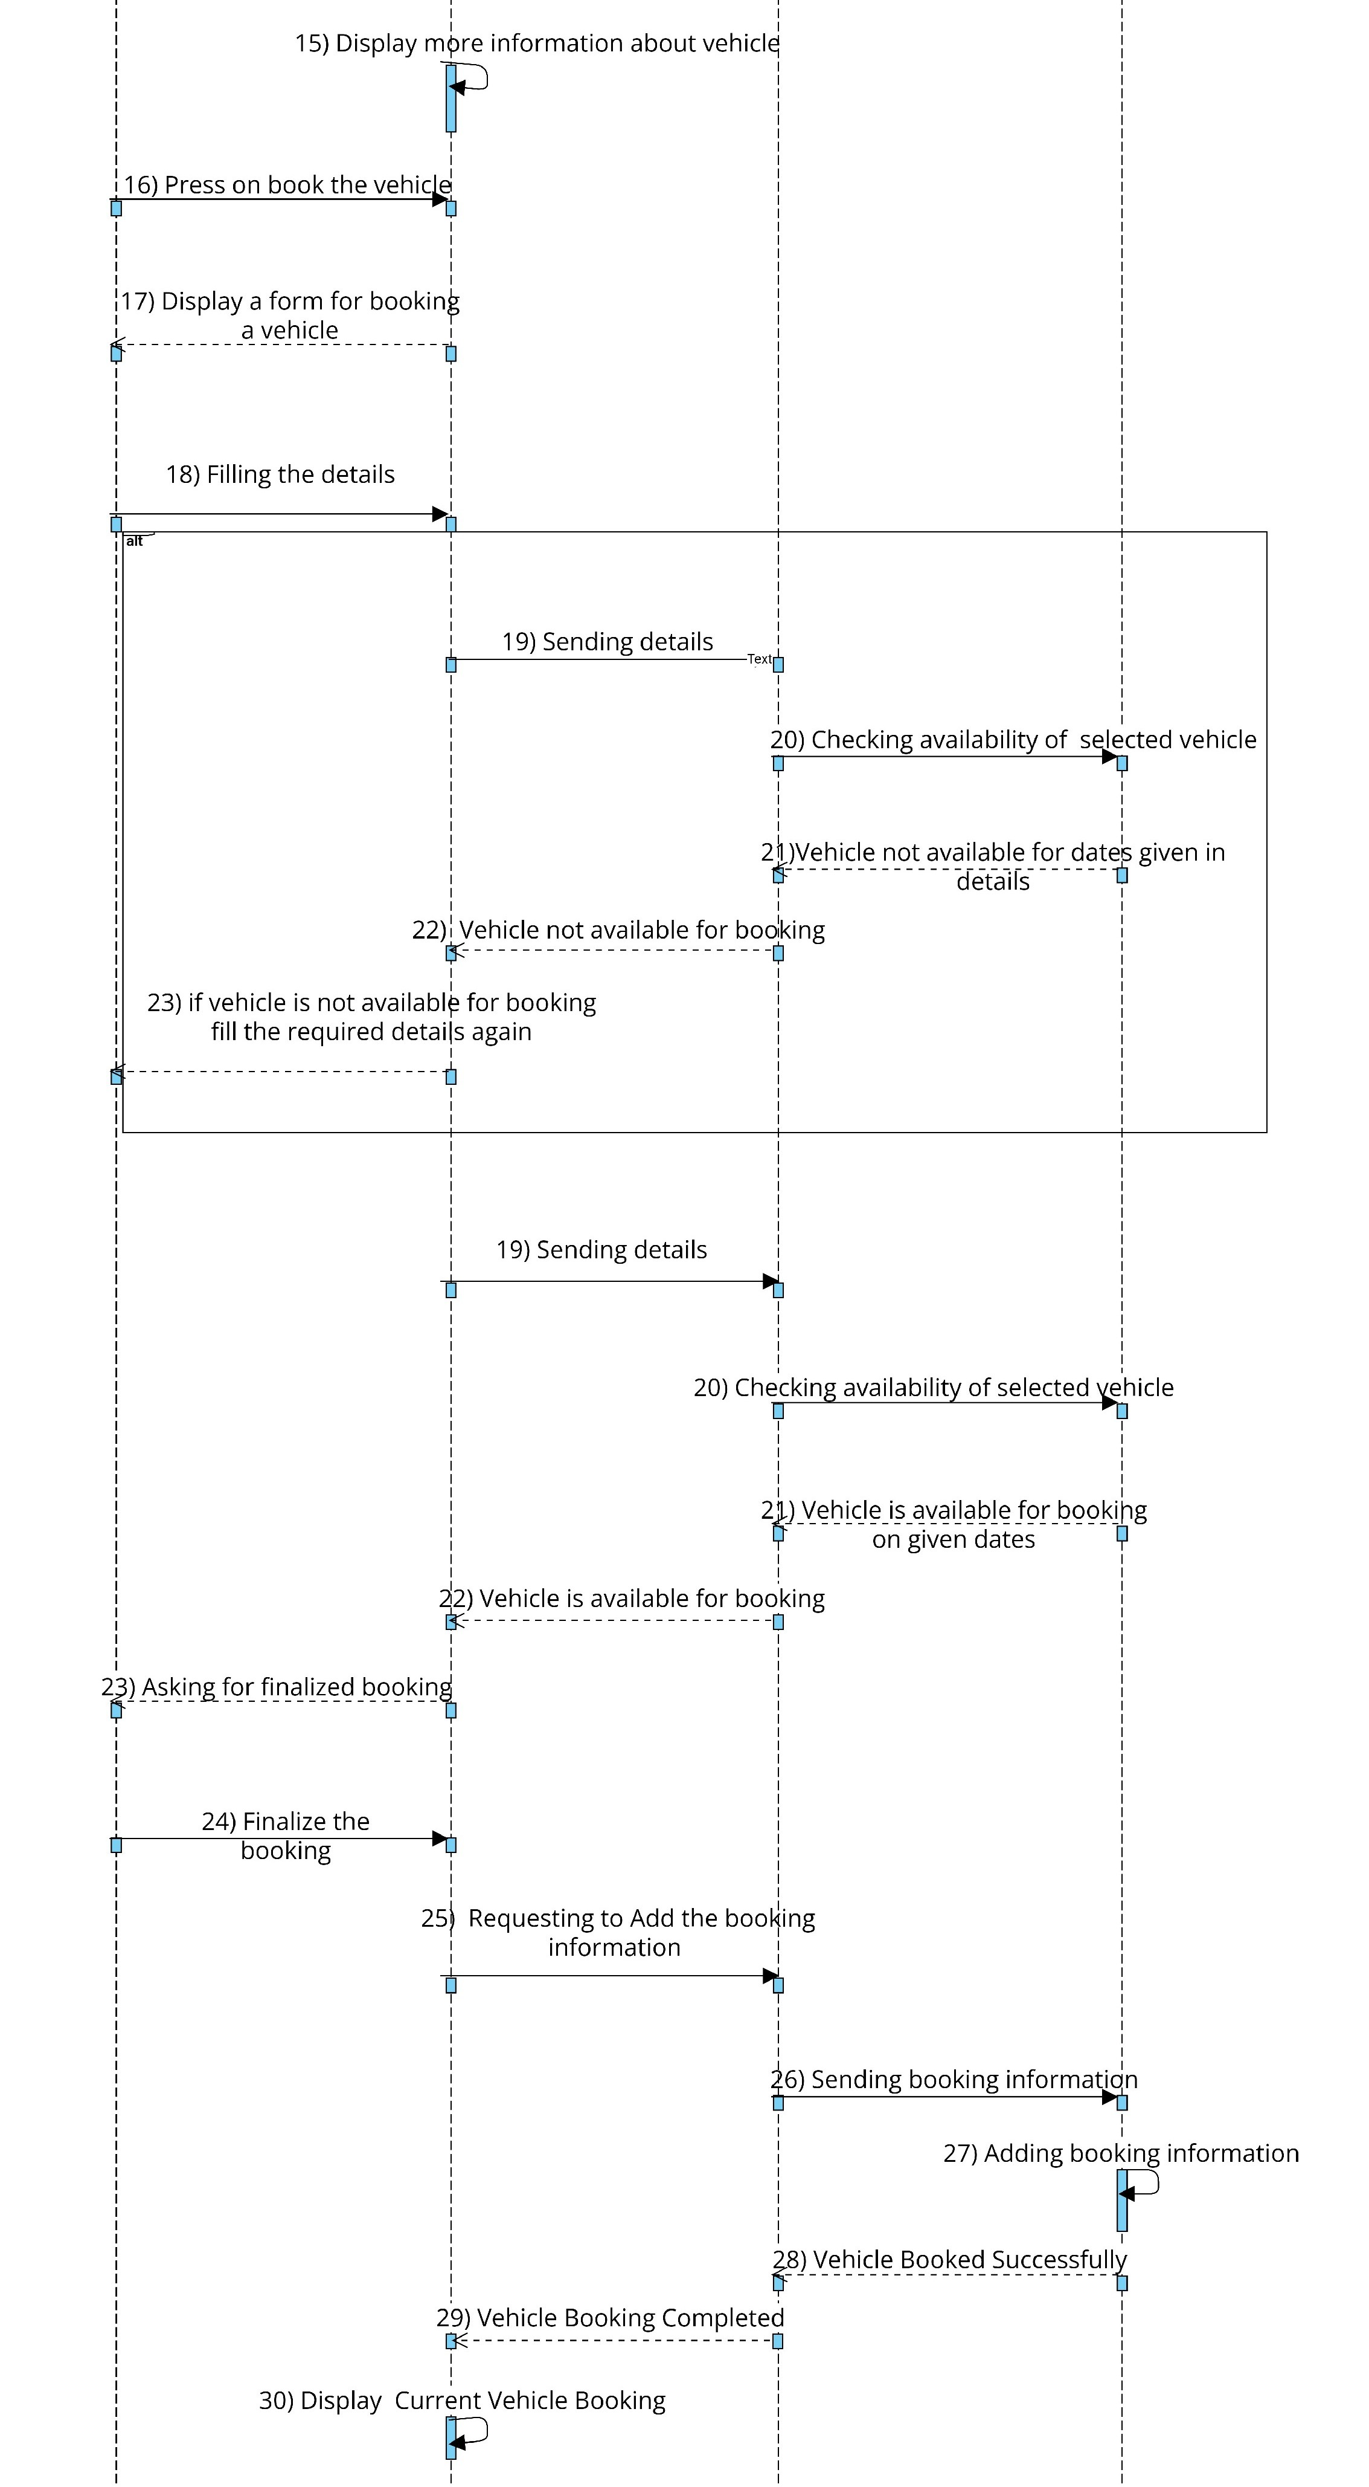
SEQUENCE DIAGRAM
VEHICLE BOOKING SEQUENCE DIAGRAM

Slide 33
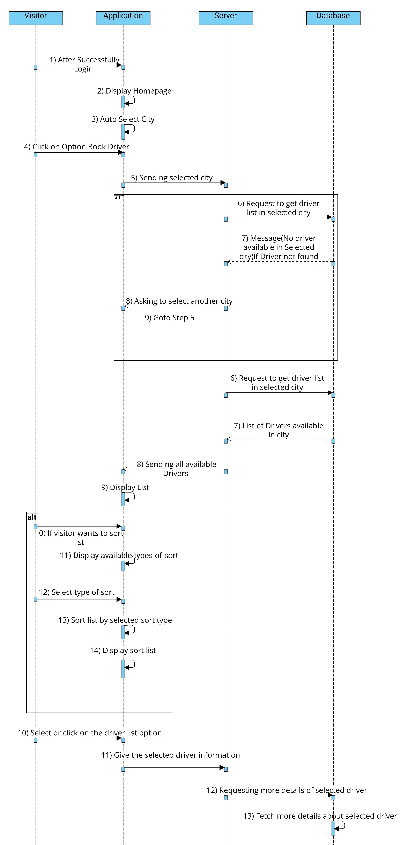
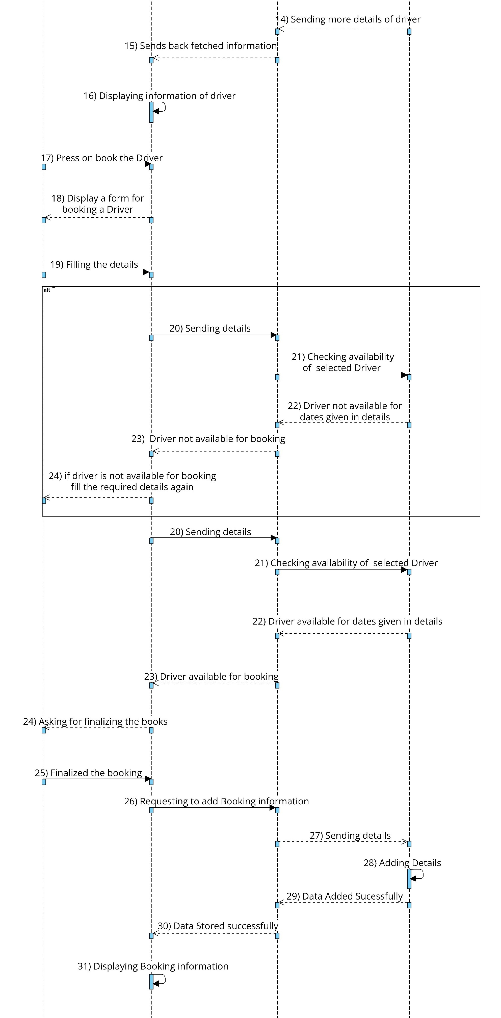
SEQUENCE DIAGRAM
DRIVER BOOKING SEQUENCE DIAGRAM

Slide 34
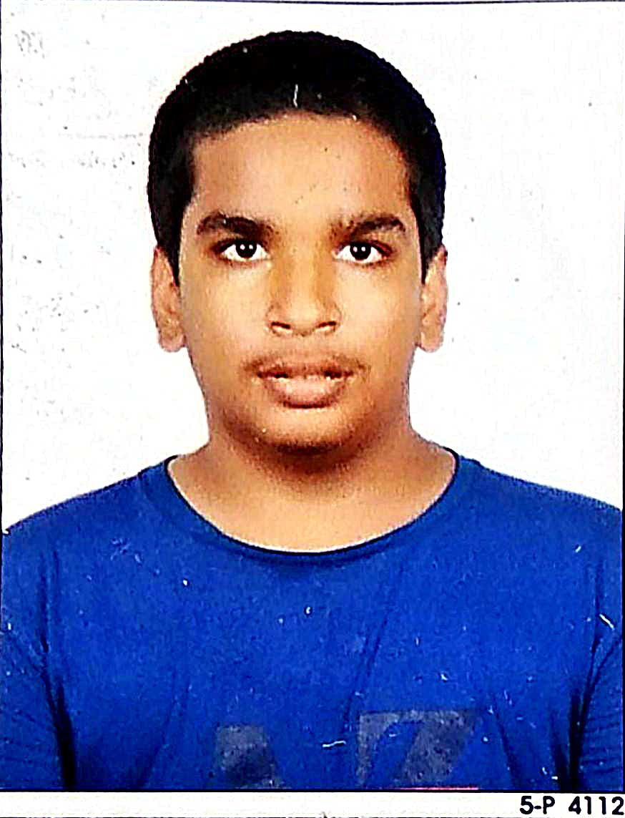



Meet our team
Harshil Patel
Group Leader
Member
Member
Member
Ayan Rana
Parmar Kirtan
Sneh Gohel

Slide 35

Summary
The basic purpose of the System is to provide better expression to the customer. The vehicle rental system manages the detail about the vehicle, customer, driver, and vehicle owner. the application reduces the manual work of managing the vehicle and booking. the system provides search facilities on various factors such as vehicle, area, etc.
Vehicle Rental
System

Slide 36
THANK YOU

